Slide 1

So'rovlar va javoblar

Slide 2
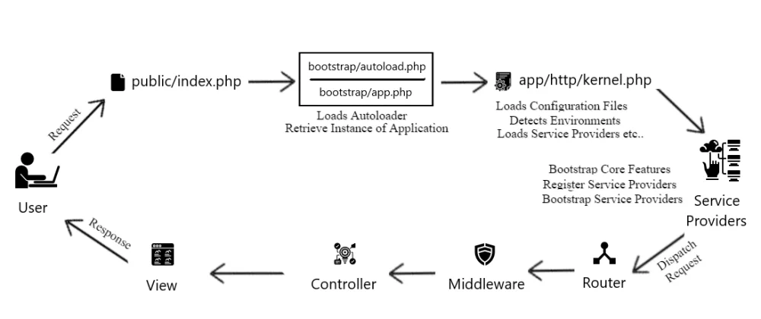
Laravelda so'rov

Slide 3
Request obyekti
Nomlar fazosi: use Illuminate\Http\Request;
Ishlatish:
class UserController extends Controller
{
public function store(Request $request)
{
$name = $request->input('name');
// ...
}
}

Slide 4
Request obyekti va parametrlar
Request obyekti controller metodlarida doim birinchi bo'lishi kerak:
Route faylida:
use App\Http\Controllers\UserController;
Route::put('/user/{id}', [UserController::class, 'update']);
Controllerda:
<?php
namespace App\Http\Controllers;
use Illuminate\Http\Request;
class UserController extends Controller
{
public function update(Request $request, $id)
{
// ...
}
}

Slide 5
Request obyekti metodlari
$uri = $request->path() – so'rov kelgan manzilni qaytaradi
$request->is('admin/*') – so'rov kelgan manzilni tekshiradi
$request->routeIs('admin.*') – so'rov kelgan nomlangan routeni tekshiradi
$request->url(), $request->fullUrl(), – so'rov kelgan URL manzilni (so'rovsiz, to'liq) qaytaradi
$request->method() – so'rov usulini olish
$request->isMethod('post') – so'rov usulini tekshirish
$request->bearerToken() – Authorization orqali keladigan bearer tokenni oladi, mavjud bo'lmasa bo'sh satr qaytaradi
$ipAddress = $request->ip() – so'rov kelgan ip manzilni qaytaradi
https://laravel.com/docs/9.x/requests#interacting-with-the-request

Slide 6
Request obyektidan berilganlarni ajratish
$input = $request->all() – so'rovda kelgan berilganlarni massiv ko'rinishida olish
$input = $request->collect() – so'rovda kelgan berilganlarni kolleksiya ko'rinishida olish
$name = $request->input('name') – so'rovdan nomi bo'yicha qiymat olish
$name = $request->input('name', 'Sally') - so'rovdan nomi bo'yicha qiymat olish (kelishuv bo'yicha qiymat agar mavjud bo'lmasa)
So'rovda JSON jo'natilgan bo'lsa . orqali elementlarga murojaat qilish mumkin: $name = $request->input('user.name');
$archived = $request->boolean('archived') - 1, "1", true, "true", "on", va "yes" qiymatlar uchun true, aks holda false qiymat oladi
$birthday = $request->date('birthday') – Carbon obyekt ko'rinishida sana oladi (https://carbon.nesbot.com/)
$name = $request->name – So'rov berilganlarni dinamik xossalar sifatida ishlatish

Slide 7
Request obyektdan ma'lumotlarni ajratib olish
Faqat ko'rsatilgan berilganlarni olish:
$input = $request->only(['username', 'password']);
$input = $request->only('username', 'password');
Faqat ko'rsatilmagan berilganlarni olish:
$input = $request->except(['credit_card']);
$input = $request->except('credit_card');

Slide 8
Request obyektini sessiya saqlash
$request->flash(); $request->flashOnly(['username', 'email']); $request->flashExcept('password'); – so'rov obyektini sessiyaga joylash uchun ishlatiladi.
Ko'pincha kelgan so'rovni sessiyaga joylab yana oldingi sahifaga qaytish amali ishlatiladi. Buning uchun maxsus withInput() metodi mavjud:
return redirect('form')->withInput();
return redirect()->route('user.create')->withInput();
return redirect('form')->withInput(
$request->except('password')
);
Sessiyaga joylangan so'rov elementlarini ishlatish uchun old() funksiyasidan foydalaniladi:
$username = $request->old('username');
<input type="text" name="username" value="{{ old('username') }}">

Slide 9
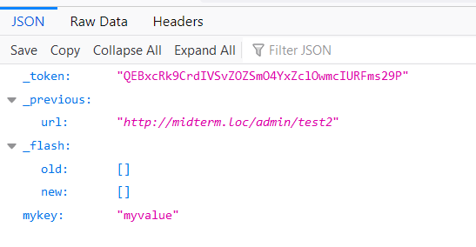
Sessiya
Sessiyaga qiymat joylash:
// Request obyekti orqali $request->session()->put('key', 'value');
// Global "session" helper orqali session(['key' => 'value']);
Sessiyadan o'qish:
$value = $request->session()->get('key');
$value = session('key');
$value = session()->get('key');
Sessiyadan o'chirish:
$request->session()->forget('name');
$request->session()->forget(['name', 'status']);
$request->session()->flush();

Slide 10
Sessiya
Qisqa muddatli sessiya ma'lumotlari (keying so'rovdan so'ng sessiyadan o'chiriladi:
// Request obyekti orqali $request->session()->flash('message', 'Task-flash was successful!'); return redirect()->route('talaba.index')
Sessiya ma'lumotlarini blade faylda o'qish:
@if (session()->has('message'))
<div class="alert alert-success">{{session()->get('message')}}</div>
@endif
@if (session()->has('message'))
<script>
M.toast({
html: "{{session()->get('message')}}"
})
</script>
@endif

Slide 11
Validatsiya qoidalari
Request obyektidagi validate() metodi orqali maydonlarni turli validatsiya qoidalari bilan tekshirish mumkin:
public function store(Request $request)
{
$request->validate([
'familiya' => 'required|string|min:5|max:20',
'ism' => 'required|string|min:5|max:20',
'kurs' => 'integer|min:1|max:4',
]);
// Xatolar bo'lmasa ishlaydigan kod qismi
}
Qoidalarni satr o'rniga massiv orqali ham berish mumkin:
$validatedData = $request->validate([
'title' => ['required', 'unique:posts', 'max:255'],
'body' => ['required'],
]);
https://laravel.com/docs/9.x/validation#available-validation-rules

Slide 12
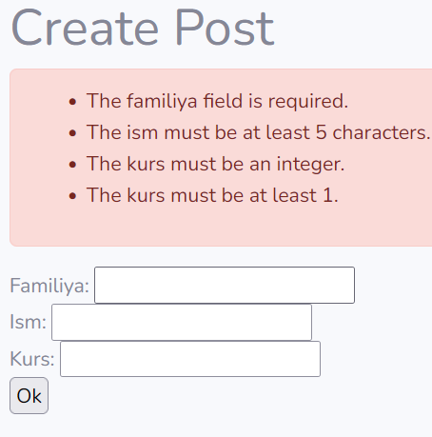
Validatsiya xatolarini chop qilish
So'rov maydonlari validatsiya qoidalaridan o'ta olmaganda: - foydalanuvchi oldingi url manzilga qaytariladi; - so'rov maydonlari avtomatik tarzda sessiyaga yoziladi; - validatsiya xatolari avtomatik sessiyaga yoziladi.
Xato haqidagi xabarlar lang/en/validation.php faylda yozilgan.
Xatolar haqidagi xabarlar maxsus $errors o'zgaruvchisiga yuklanadi:
<h1>Create Post</h1>
@if ($errors->any())
<div class="alert alert-danger">
<ul>
@foreach ($errors->all() as $error)
<li>{{ $error }}</li>
@endforeach
</ul>
</div>
@endif

Slide 13
Validatsiya xatolarini chop qilish
$errors o'zgaruvchisida barcha maydonlar uchun xatolar xabarlari saqlanadi.
$errors->first('email') - maydon uchun birinchi xato xabarini olish
$errors->get('email') – maydon uchun barcha xato xabarlarini massiv ko'rinishida olish
$errors->all() – barcha maydonlar uchun xato xabarlarini olish
$errors->has('email') – maydon uchun xato xabari mavjud yoki yo'qligini tekshirish
@error direktivasi yordamida Blade faylda berilgan atribut uchun xato mavjud yoki yo'qligini tekshirish mumkin, direktiva ichida $message o'zgaruvchisida xatolar haqida xabar chiqariladi.

Slide 14
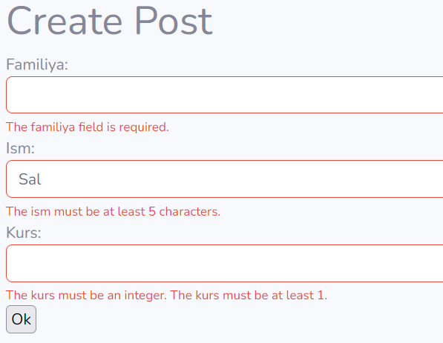
Validatsiya xatolarini chop qilish
<form action="{{route('talaba.create')}}" method=get class="form">
Familiya: <input type="text" name="familiya" value="{{old('familiya')}}" class="form-control @error('ism') is-invalid @enderror">
@error('familiya')
<div class="invalid-feedback">{{ $message }}</div>
@enderror
Ism: <input type="text" name="ism" value="{{old('ism')}}" class="form-control @error('ism') is-invalid @enderror">
@error('ism')
<div class="invalid-feedback">{{ $message }}</div>
@enderror
Kurs: <input type="text" name="kurs" value="{{old('kurs')}}" class="form-control @error('kurs') is-invalid @enderror">
@error('kurs')
<div class="invalid-feedback">
@if ($errors->has('kurs'))
@foreach ($errors->get('kurs') as $m)
{{$m}}
@endforeach
@endif
</div>
@enderror
<input type="submit" value="Ok">
</form>

Slide 15
Forma uchun Request obyektlarini yaratish
Artisan buyruqlari yordamida make:request buyrug'i orqali yaratiladi.
php artisan make:request StorePostRequest
Natijada App\Http\Requests\ papkani ichida mos fayl yaratiladi. Faylda quyidagi metodlarni va xossalarni aniqlash mumkin:
authorize() – foydalanuvchi shu so'rovni amalga oshirishga huquqi mavjud yoki yo'qligini aniqlash, true yoki false qaytaradi
rules() – so'rov uchun qoidalar, qoidalar massivini qaytaradi
messages() – xatolar haqidagi xabarlarni o'zgartirish, ['atribut.qoida' => 'xabar'] ko'rinishidagi massiv qaytarishi kerak.
protected $stopOnFirstFailure = true; – birinchi xato duch kelish bilan qolganlarini tekshirishni to'xtatish
protected $redirect = '/dashboard'; – xatolar topilganda qaysi url manzilga yo'naltirish
protected $redirectRoute = 'dashboard'; – xatolar topilganda qaysi nomlangan routega yo'naltirish

Slide 16
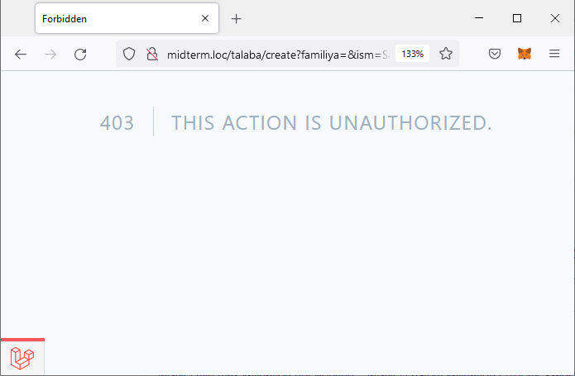
Forma uchun Request obyektlarini yaratish
class MyFormRequest extends FormRequest
{
public function authorize()
{
// return false;
// $comment = Comment::find($this->route('comment'));
// return $comment && $this->user()->can('update', $comment);
return true;
}
public function rules()
{
return [
'familiya' => 'required|string|min:5|max:20',
'ism' => 'required|string|min:5|max:20',
'kurs' => 'integer|min:1|max:4',
];
}

Slide 17
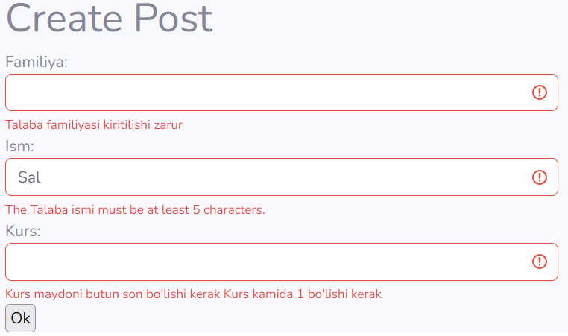
Forma uchun Request obyektlarini yaratish
public function messages()
{
return [
'familiya.required' => ':attribute kiritilishi zarur',
'ism.required' => 'Ism maydoni kiritilishi zarur',
'kurs.required' => ':attribute kiritilishi zarur',
'kurs.integer' => 'Kurs maydoni butun son bo\'lishi kerak',
'kurs.min' => ':attribute kamida :min bo\'lishi kerak',
'kurs.max' => ':attribute kamida :max bo\'lishi kerak',
];
}
public function attributes()
{
return [
'familiya' => 'Talaba familiyasi',
'ism' => 'Talaba ismi',
'kurs' => 'Kurs',
];
}
}

Slide 18
Javoblar (HTTP Responses)
Javoblar:
Route::get('/', function () {
#satr javoblar
return 'Hello World';
#massiv javoblar
return [1, 2, 3];
# response obyekti
return response('Hello World', 200)
->header('Content-Type', 'text/plain');
});
#Eloquent obyekt yoki kolleksiya
use App\Models\User;
Route::get('/user/{user}', function (User $user) {
return $user;
});

Slide 19
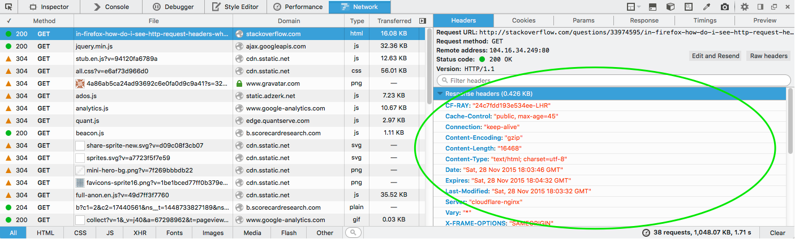
Javoblar (HTTP Responses)
Javoblarga sarlavhalarni (Header) qo'shish:
return response($content)
->header('Content-Type', $type)
->header('X-Header-One', 'Header Value')
->header('X-Header-Two', 'Header Value');
return response($content)
->withHeaders([
'Content-Type' => $type,
'X-Header-One' => 'Header Value',
'X-Header-Two' => 'Header Value',
]);

Slide 20
Javoblar (yo'naltirish)
Route::get('/dashboard', function () {
# url manzilga yo'naltirish
return redirect('admin/dashboard');
# nomlangan routega yo'naltirish
return redirect()->route('admin.dashboard');
});
# parametrli route
Route::get('/profile/{id}', [TalabaController::class, 'profile'])->name('profile');
Route::get('/account', function () {
return redirect()->route('profile', ['id' => 1]);
# Eloquent model orqali
return redirect()->route('profile', [$user]);
});

Slide 21
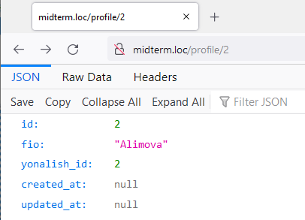
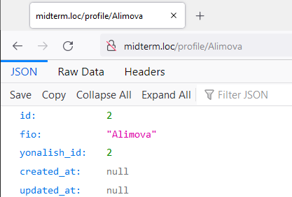
Javoblar (yo'naltirish)
Route::get('/account', function () {
# Eloquent model orqali
$t = Talaba::where("fio", "Alimova")->first();
return redirect()->route('profile', [$t]);
});
# parametrli route
Route::get('/profile/{talaba}', [TalabaController::class, 'profile'])->name('profile');
Agar kalit maydonni o'zgartirish kerak bo'lsa:
Routeda:
Route::get('/profile/{talaba:fio}', [TalabaController::class, 'profile'])->name('profile');
Yoki Eloquent modelda:
public function getRouteKeyName()
{
return 'fio';
}

Slide 22
Javoblar
Controller metodlariga:
return redirect()->action([UserController::class, 'index']); return redirect()->action(
[UserController::class, 'profile'],
['id' => 1]
);
Tashqi saytlarga:
return redirect()->away('https://www.google.com');

Slide 23
Javoblar
Qisqa muddatli sessiya bilan:
return redirect('dashboard')->with('status', 'Profile updated!');
Blade faylda sessiyani tekshirish:
@if (session('status'))
<div class="alert alert-success">
{{ session('status') }}
</div>
@endif
Oldingi sahifaga so'rovlar bilan:
return back()->withInput();

Slide 24
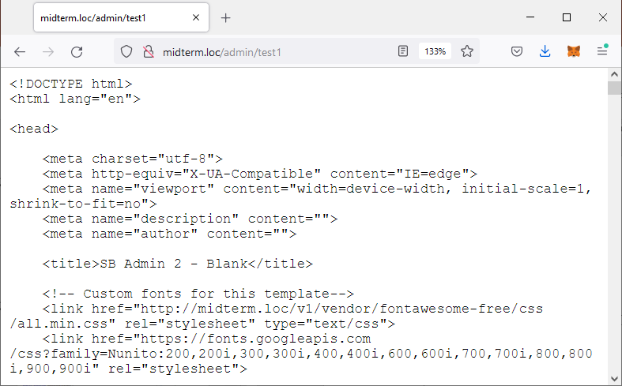
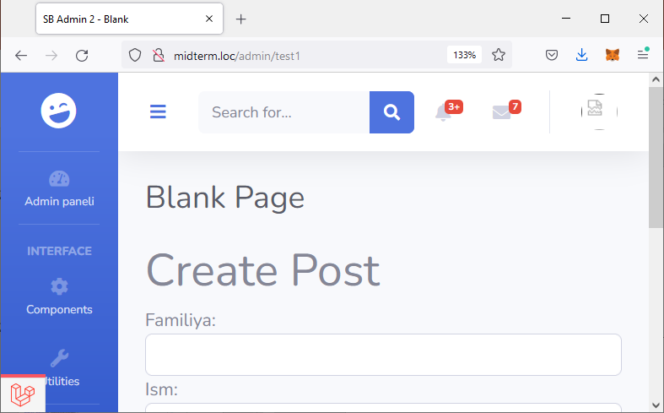
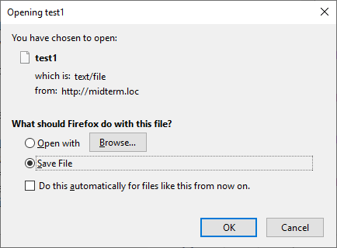
Javoblar
Shablon fayllar:
return response()
->view('talaba.index', [], 200)
->header('Content-Type', "text/plain");
# ->header('Content-Type', "text/file");
# ->header('Content-Type', "text/html");

Slide 25
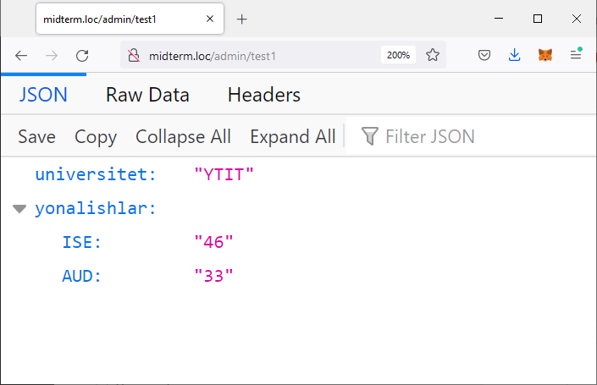
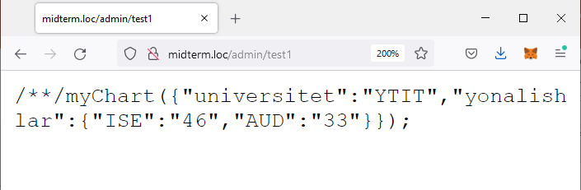
Javoblar
JSON va JSONP javoblar:
return response()->json([
'universitet' => "YTIT",
'yonalishlar' => [
'ISE' => '46',
'AUD' => '33',
]
]);
return response()->json([
'universitet' => "YTIT",
'yonalishlar' => [
'ISE' => '46',
'AUD' => '33',
]
])->withCallback('myChart');

Slide 26
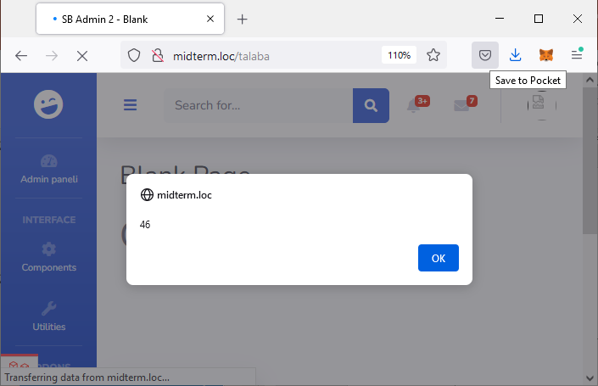
Javoblar
JSONP javob:
return response()->json([
'universitet' => "YTIT",
'yonalishlar' => [
'ISE' => '46',
'AUD' => '33',
]
])->withCallback('myChart');
index.blade.php faylda:
<script>
function myChart(json) {
alert(json.yonalishlar.ISE);
}
var elm = document.createElement("script");
elm.setAttribute("type", "text/javascript");
elm.src = "http://midterm.loc/admin/test1";
document.body.appendChild(elm);
</script>

Slide 27
Javoblar
Faylni yuklab olish uchun:
return response()->download($pathToFile); return response()->download($pathToFile, $name, $headers);
Faylni brauzerda ko'rish uchun:
return response()->file($pathToFile); return response()->file($pathToFile, $headers);

Slide 28
Middleware (vositachi)
Middleware – ilovaga keladigan HTTP so'rovlarni tekshirish va filtrlash mexanizmi.
app/Http/Middleware da joylashadi.
make:middleware artisan buyrug'i orqali yaratiladi: php artisan make:middleware EnsureTokenIsValid
namespace App\Http\Middleware;
use Closure;
class EnsureTokenIsValid
{
public function handle($request, Closure $next)
{
if ($request->input('token') !== 'my-secret-token') {
return redirect('home');
}
return $next($request);
}
}

Slide 29
Middleware (vositachi)
Vositachilar so'rovdan oldin yoki so'rov bajarilgandan so'ng amalga oshishi mumkin:
namespace App\Http\Middleware;
use Closure;
class BeforeMiddleware
{
public function handle($request, Closure $next)
{
// Perform action
return $next($request);
}
}
namespace App\Http\Middleware;
use Closure;
class AfterMiddleware
{
public function handle($request, Closure $next)
{
$response = $next($request);
// Perform action
return $response;
}
}

Slide 30
Middleware (vositachi)
Vositachini ro'yxatga olish uchun app/Http/Kernel.php sinfidagi (faylidagi) $middleware (global) yoki $routeMiddleware (routelarga biriktiriladigan) xossasiga qo'shish kerak.
protected $routeMiddleware = [
'auth' => \App\Http\Middleware\Authenticate::class,
'auth.basic' => \Illuminate\Auth\Middleware\AuthenticateWithBasicAuth::class,
...
'verified' => \Illuminate\Auth\Middleware\EnsureEmailIsVerified::class,
];
HTTP kernelda aniqlangan vositachilar routelarga middleware metodi orqali biriktiriladi:
Route::get('/profile', function () {
//
})->middleware('auth');
//})->middleware(['first', 'second']);

Slide 31
Vositachi parametrlari
Vositachi uchun qo'shimcha parametrlar $next o'zgaruvchisidan keyin aniqlanadi:
namespace App\Http\Middleware;
use Closure;
class EnsureUserHasRole
{
public function handle($request, Closure $next, $role)
{
if (! $request->user()->hasRole($role)) {
// Redirect...
}
return $next($request);
}
}
HTTP kernelda aniqlangan vositachilar routelarga middleware metodi orqali biriktiriladi:
Route::put('/post/{id}', function ($id) {
//
})->middleware('role:editor');
public function handle($request, Closure $next, $a, $b)
{
if ($a == $b) {
// Redirect...
}
return $next($request);
}
public function handle($request, Closure $next, ...$roles)
{
foreach($roles as $role){
if ($request->user()->hasRole($role)){
return $next($request);
}
}
abort(404);
}
})->middleware('role:val1,val2');
})->middleware('role:val1,val2,val3,val4');

Slide 32
Savollar?

